Slide 1
SOFTWIDGET
Voice-Assisted Commerce application
Proposal
March 30, 2019

Slide 2
Agenda
The Idea - Voice Assistant Integration
Solution – Alexa
Approach – Innovation Lab
Demonstrate Alexa Skill
Development Practices
Alexa Dev Console Configuration
GitHub Practices
Unit Test
Deployment Practices
Questions

Slide 3
The Idea- Voice Assistant Integration
Before jumping into details on the proposed path forward, it’s important to level-set on the actual idea
Growing sales of Amazon Echo and Google Home suggest voice assistants aren’t a novelty item or fad. Currently, 32% of consumers own one of these devices, and that number is expected to grow, given 79% of smart-speaker sales occur in the fourth quarter of 2018, according to a survey by Adobe Analytics.
50% of voice-controlled device owners have made a purchase with one in the past year.
Voice searches are replacing traditional searches, And if you’re not optimizing for them, you’re going to miss out on a lot of Google traffic.
Three years from now, 40% of consumers will shop with the help of these devices, spending 18% of their total shopping budgets in the process, Capgemini predicts.

Slide 4
Solution - Alexa
How You (And Amazon) Get People To Buy Things Via Alexa

Slide 5
Approach – Innovation Lab
Cyber Group prefers taking the “Innovation Lab” track for the following reasons:
Our team at Innovation Lab is constantly working on exploring and learning new techs/products.
Properly sets expectations by demonstrating quick POC
This will also give you an idea about standards we follow through developing an application.

Slide 6
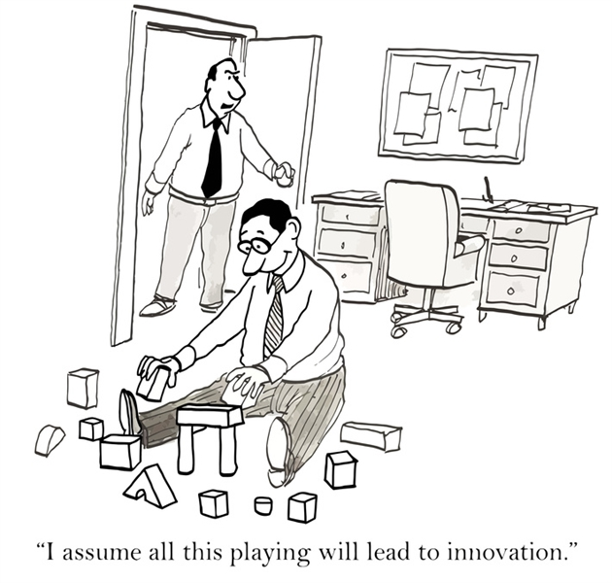
Demonstrate Alexa Skill

Slide 7
Development Practices
Alexa Dev Console Configuration
GitHub Practices
Unit Test
Deployment Practices

Slide 8
QUESTIONS

